Slide 1
Complete Threat Analysis of MediSecure / Health Company
The following report is a complete brake down of the threat analysis of the MediSecure Company.
The below report will cover the following topics,
Searching for vulnerabilities related to the compromised Win2022 VM System
Generating a Nessus report
Using Powershell code to run, to identify vulnerabilities
Sysmon, Nmap and WafW00f
Threat Analysis report of the system MediSecure is using of,
Who is the Threat Actor
What techniques are used by the threat actor
A look at a few CVEs related to the vulnerabilities that have been identified
Demonstration of two attacks related to the techniques that the threat actor might use to exploit the vulnerabilities discovered

Slide 2

Nmap of 192.168.56.50 / Win2022
Nmap is used for the purpose of is to scan a network IP Address for open and exposed ports, it may also be used to scan for other applications that might be installed on the system or vulnerabilities.
Nmap also has the capabilities to identify all devices on a network, find information about the operating system
The Below code scans the IP address 192.168.56.50 for open ports
PS C:\Users\vagrant> nmap 192.168.56.50
Starting Nmap 7.95 ( https://nmap.org ) at 2024-08-23 13:15 E. Australia Standard Time
Nmap scan report for DC (192.168.56.50)
Host is up (0.00067s latency).
Not shown: 994 closed tcp ports (reset)
PORT STATE SERVICE
135/tcp open msrpc
139/tcp open netbios-ssn
445/tcp open microsoft-ds
3389/tcp open ms-wbt-server
5357/tcp open wsdapi
5985/tcp open wsman
Nmap done: 1 IP address (1 host up) scanned in 5.14 seconds

Slide 3
Open ports discovered by Nmap on 192.168.56.50
135/tcp – If this port is open for the public to access then it might be exploited to run a RCE (Remote Command Execution)
139/tcp – If this port is not made secure it can be exploited to run ransomware on sensitive/ crucial data
445/tcp – This port might be used to gain unauthorized access to systems and sensitive files
3389/tcp – leaving port 3389 open to this public can lead to a direct tunnel into the system to be controlled remotely
5357/tcp – If left open it might be exposed to remote access by unauthorised personal
5958/tcp – Can be used to run ransomware if exposed to the public

Slide 4
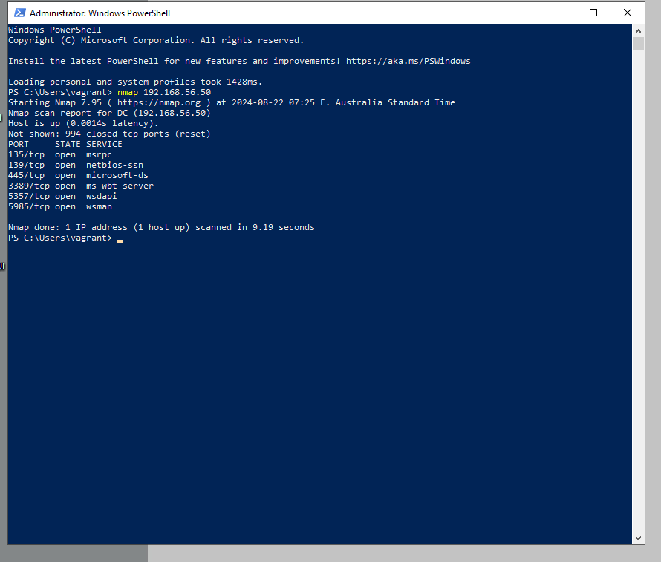
Nmap Scan Code of 192.168.56.50
Image of Nmap results

Slide 5
Sysmon of 192.168.56.50 / Win2022
Sysmon is a very useful tool to detect all events that have happened on a system
Apart from detecting event logs, it also provides information as well
Network connections
Modification to file time and date stamp
Process run on a system
Sysmon also allows has the ability to scan a network for specific attack techniques
The below code demonstrates a Sysmon scan of IP Address 192.168.56.50
In the code you can see that it is searching for the techniques ID for the following possible attacks, as well as out putting the most recent 10 event logs
T1047 (Windows Management Instrumentation)
T1204 (User Execution)
T1053.005 (Scheduled Task/Job: Scheduled Task)
T1059 (Command and Scripting Interpreter)

Slide 6
Sysmon of 192.168.56.50 / Win2022
T1047 (Windows Management Instrumentation)
Windows Management Instrumentation (WMI) can be remotely access by unauthorized users to gather information on files in the system or to run malicious code
T1204 (User Execution)
User opens a malicious links and un knowingly executing the code that has been imbedded, This is also known as “Phishing”
T1053.005 (Scheduled Task/Job: Scheduled Task)
Attacker may use Windows Task Scheduler to set up script to run on a persistence or periodical basis's, also can be used to run script remotely
T1059 (Command and Scripting Interpreter)
Attackers can embed commands and scripts in Initial Access payloads, commonly disguised as lure documents, or utilize them as secondary payloads downloaded from an existing command and control (C2) server.

Slide 7
Sysmon of 192.168.56.50 / Win2022
PS C:\Users\vagrant> Get-WinEvent -LogName 'Microsoft-Windows-Sysmon/Operational' |
>> Where-Object { $_.Message -like "*T1059*" -or
>> $_.Message -like "*T1053.005*" -or
>> $_.Message -like "*T1204*" -or
>> $_.Message -like "*T1047*" } |
>> Sort-Object TimeCreated -Descending |
>> Select-Object -First 10 |
>> Format-List -Property Message
>>
Message : Image loaded:
RuleName: technique_id=T1059.001,technique_name=PowerShell
UtcTime: 2024-09-16 10:43:35.912
ProcessGuid: {8a79a039-0b87-66e8-5308-000000001800}
ProcessId: 4888
Image: C:\Windows\System32\CompatTelRunner.exe
ImageLoaded: C:\Windows\System32\amsi.dll
FileVersion: 10.0.20348.2520 (WinBuild.160101.0800)
Description: Anti-Malware Scan Interface
Product: Microsoft® Windows® Operating System
Company: Microsoft Corporation
OriginalFileName: amsi.dll
Hashes: SHA1=2A3C1504B53CE77A5B95935CDBE7BA473169ED63,MD5=A82273D5869F5A05303A00126E0162AF,SHA256=B42DBB38EB1EC2C07895F0A18076EC9E07A52DCA58DD79FB325E8C302960D06E,IMPHASH=039A8C4DDEC776FDB61F493B45D37109
Signed: true
Signature: Microsoft Windows
SignatureStatus: Valid
User: NT AUTHORITY\SYSTEM
Message : Process Create:
RuleName: technique_id=T1059.001,technique_name=PowerShell
UtcTime: 2024-09-16 10:43:34.274
ProcessGuid: {8a79a039-0bd6-66e8-9008-000000001800}
ProcessId: 8104
Image: C:\Windows\System32\HOSTNAME.EXE
FileVersion: 10.0.20348.2520 (WinBuild.160101.0800)
Description: Hostname APP
Product: Microsoft® Windows® Operating System
Company: Microsoft Corporation
OriginalFileName: hostname.exe
CommandLine: "C:\Windows\system32\HOSTNAME.EXE"
CurrentDirectory: C:\Users\vagrant\
User: DC\vagrant
LogonGuid: {8a79a039-95fd-66c1-dd53-050000000000}

Slide 8
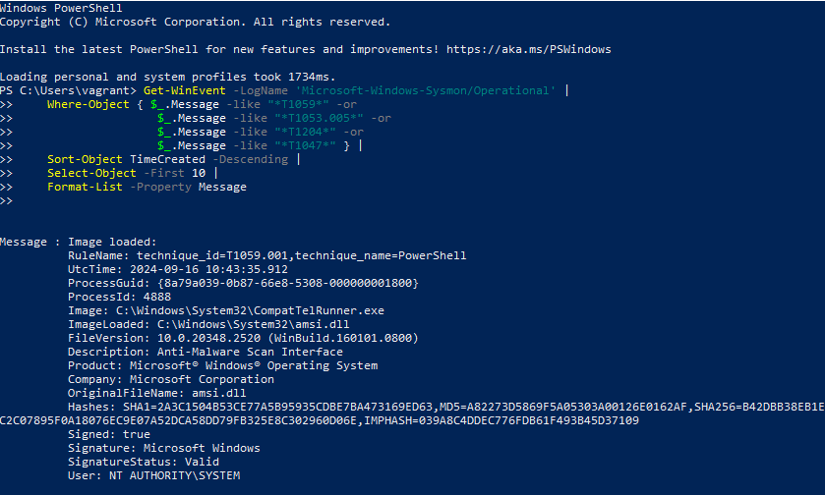
Sysmon of 192.168.56.50 / Win2022
Below is the out put of the Sysmon scan, showing the first 10 events

Slide 9
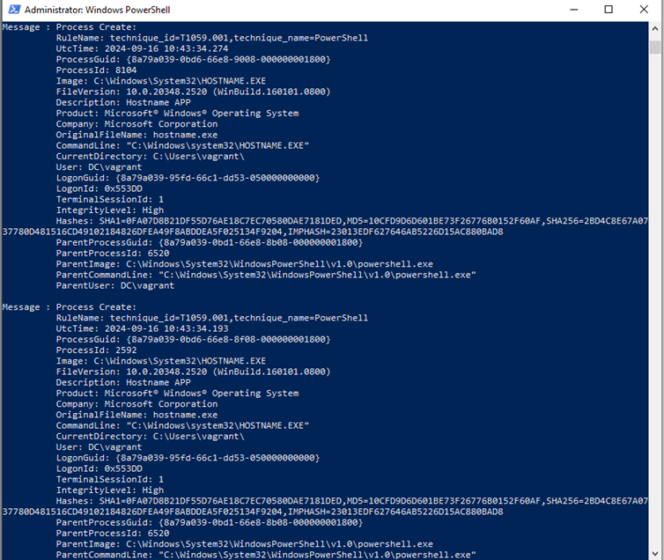
Sysmon of 192.168.56.50 / Win2022

Slide 10
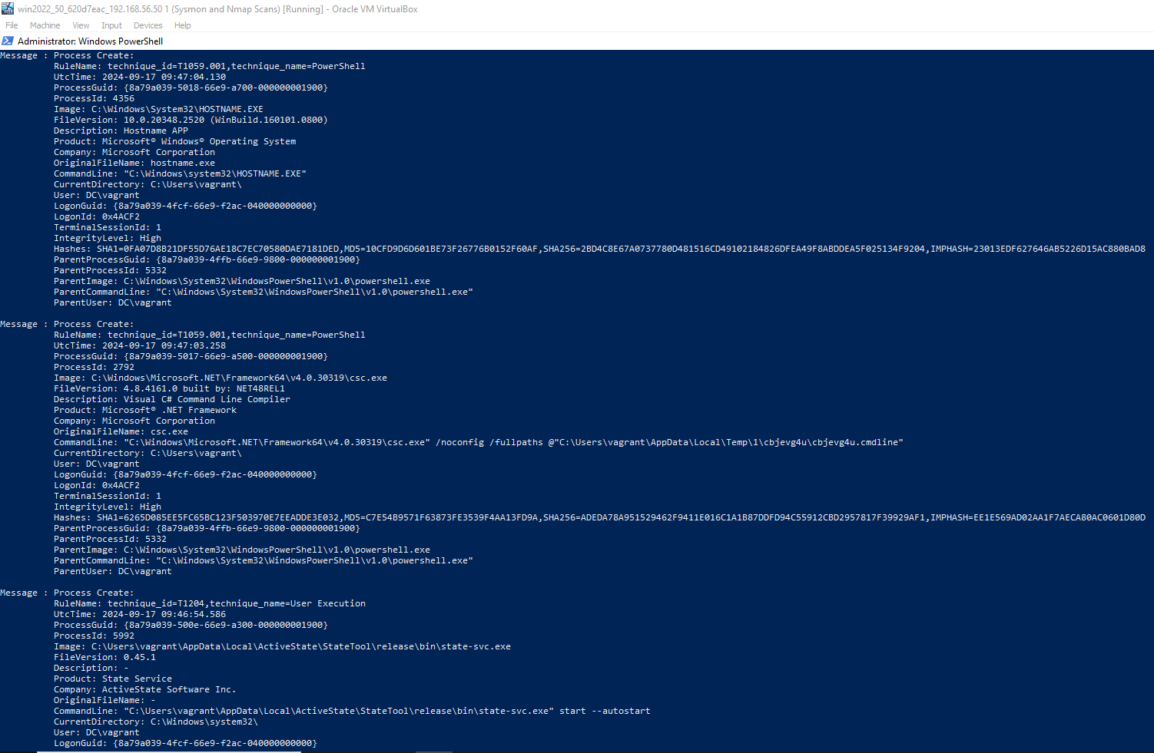
Sysmon of 192.168.56.50 / Win2022

Slide 11
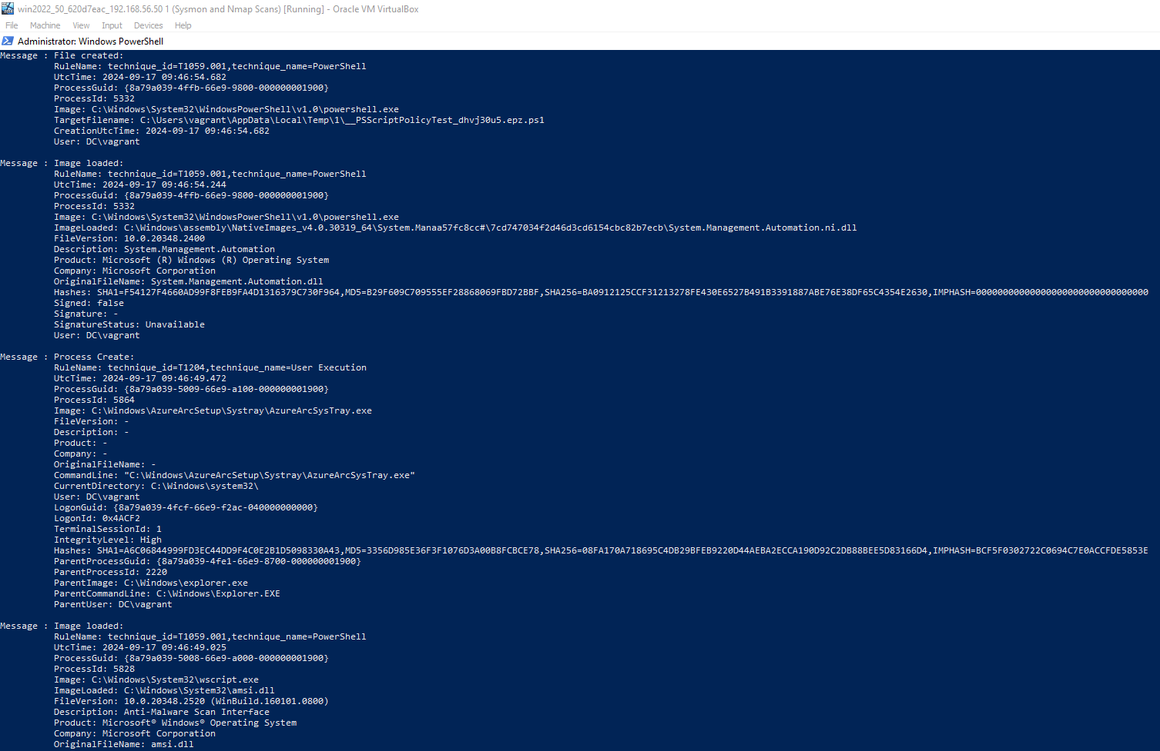
Sysmon of 192.168.56.50 / Win2022

Slide 12
Wafw00f
WafW00f is used to detect firewalls and what type of firewalls they are.
WafW00f does this by sending out a HTTP request and then analyses the response it gets

Slide 13
Wafw00f Code
PS C:\Users\vagrant> cd wafw00f
PS C:\Users\vagrant\wafw00f> wafw00f www.amazon.com
______
/ \
( Woof! )
\ ____/ )
,, ) (_
.-. - _______ ( |__|
()``; |==|_______) .)|__|
/ (' /|\ ( |__|
( / ) / | \ . |__|
\(_)_)) / | \ |__|
~ WAFW00F : v2.2.0 ~
The Web Application Firewall Fingerprinting Toolkit
[*] Checking https://www.amazon.com
[+] The site https://www.amazon.com is behind Cloudfront (Amazon) WAF.
[~] Number of requests: 2
PS C:\Users\vagrant\wafw00f> wafw00f cqu.edu.au
______
/ \
( Woof! )
\ ____/ )
,, ) (_
.-. - _______ ( |__|
()``; |==|_______) .)|__|
/ (' /|\ ( |__|
( / ) / | \ . |__|
\(_)_)) / | \ |__|
~ WAFW00F : v2.2.0 ~
The Web Application Firewall Fingerprinting Toolkit
[*] Checking https://cqu.edu.au
[+] The site https://cqu.edu.au is behind Azure Front Door (Microsoft) WAF.
[~] Number of requests: 2
PS C:\Users\vagrant\wafw00f>

Slide 14
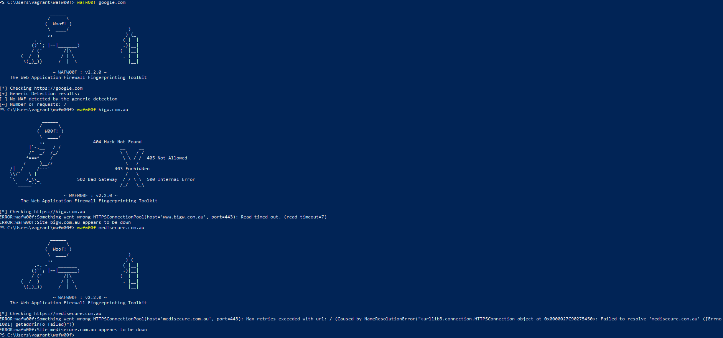
Wafw00f

